Slide 1

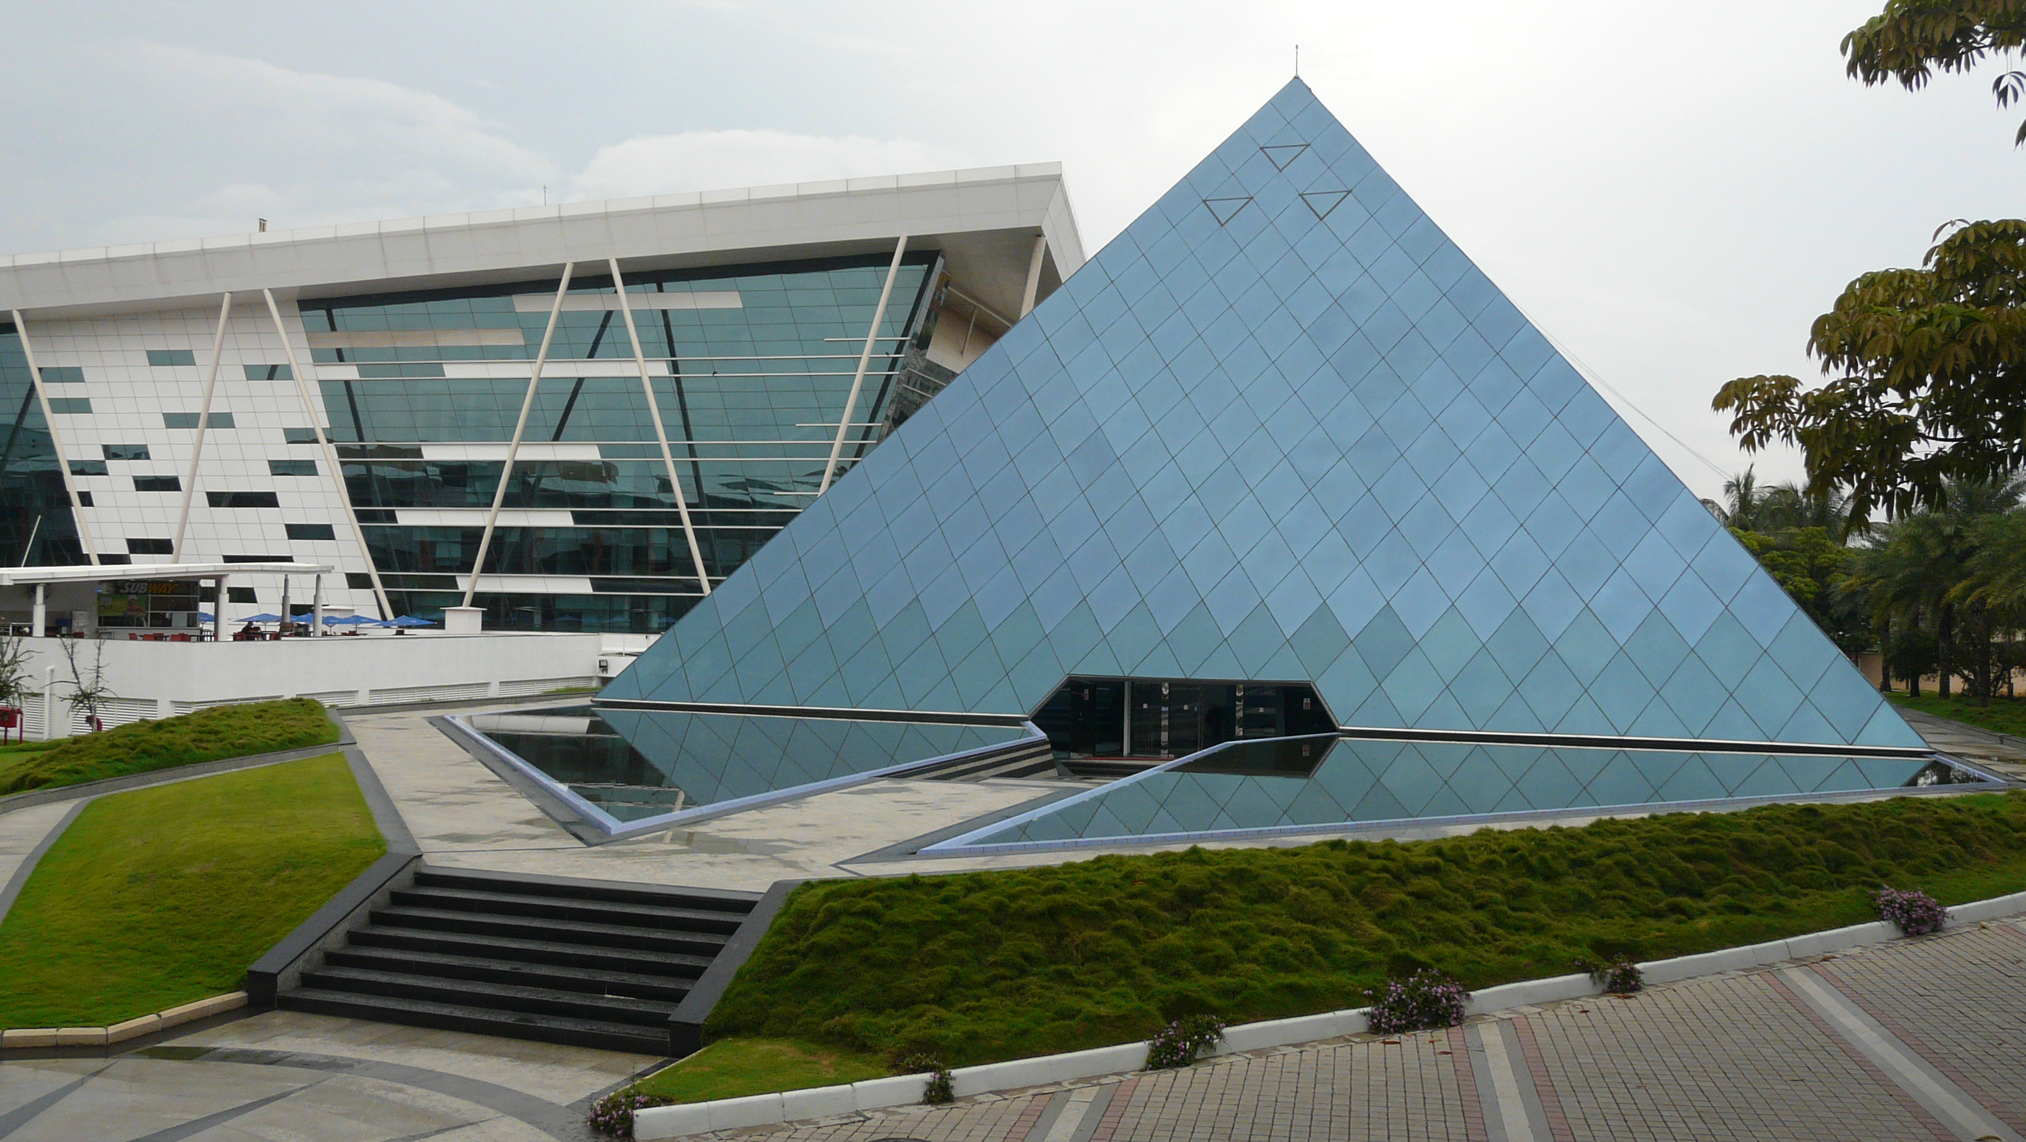

INFOSYS FINAL REPORT
August 2024

Slide 2
TABLE OF CONTENT
01
02
03
Project overview
My role in the project
Project agenda
04
05
Demonstration
Futur work

Slide 3
PROJECT OVERVIEW
LLM (Large Language Model) powered by RAG (Retrieval-Augmented Generation) can generates accurate and contextually relevant responses by leveraging a vast knowledge base.
Highly interesting for Infosys due to significant opportunities to enhance information accuracy and relevance.
Problem : hard to extract multimodal data from corporate documents (text, tables, and images) and convert this data into vectors for developing LLM-powered RAG systems.
Project : Create a solution and demonstrate it using an open-source library like deepdoctection.

Slide 4

MY ROLE IN THE PROJECT
Investigate various open-source and cloud-based solutions
Understand the deepdoctection library
Have a first pipline of extracting table from documents.
Add features (text/title detections)

Slide 5
1 week Understand the problem and read about deepdoctection library. | 2 weeks Start coding and implementing a pipline for table detection. | 1 week Implement the result of table detection in a concrete exemple. | 2 weeks Add features for graph, text and title detection | 2 weeks Implement all the result in a prototype to show the capability of this library. | Final product A tool that take multi-modal data and extract all the informations.
PROJECT AGENDA AND END OBJECTIVE
6
5
4
3
2
1

Slide 6
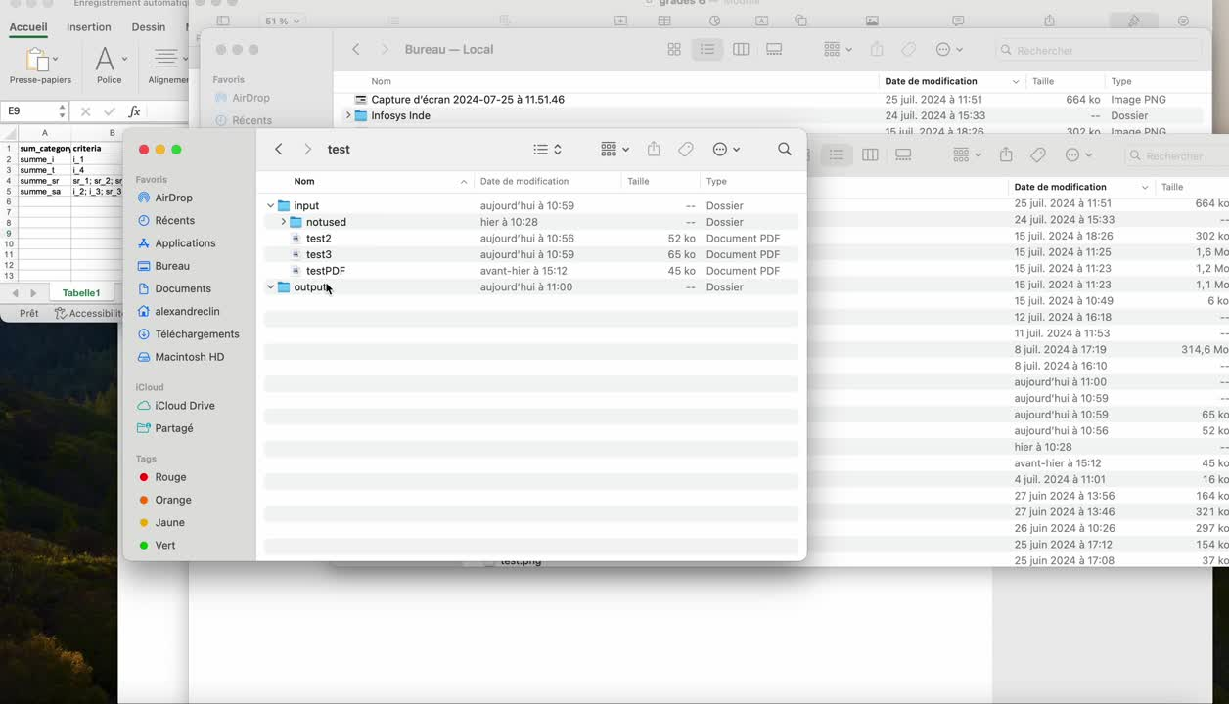
DEMO
https://github.com/alexxelaalexxela/Multi-modal-detection-deep-learning

Slide 7

WHAT’S NEXT ?
Improve the features and add graph detection
Implement it in a RAG model to see the result

Slide 8
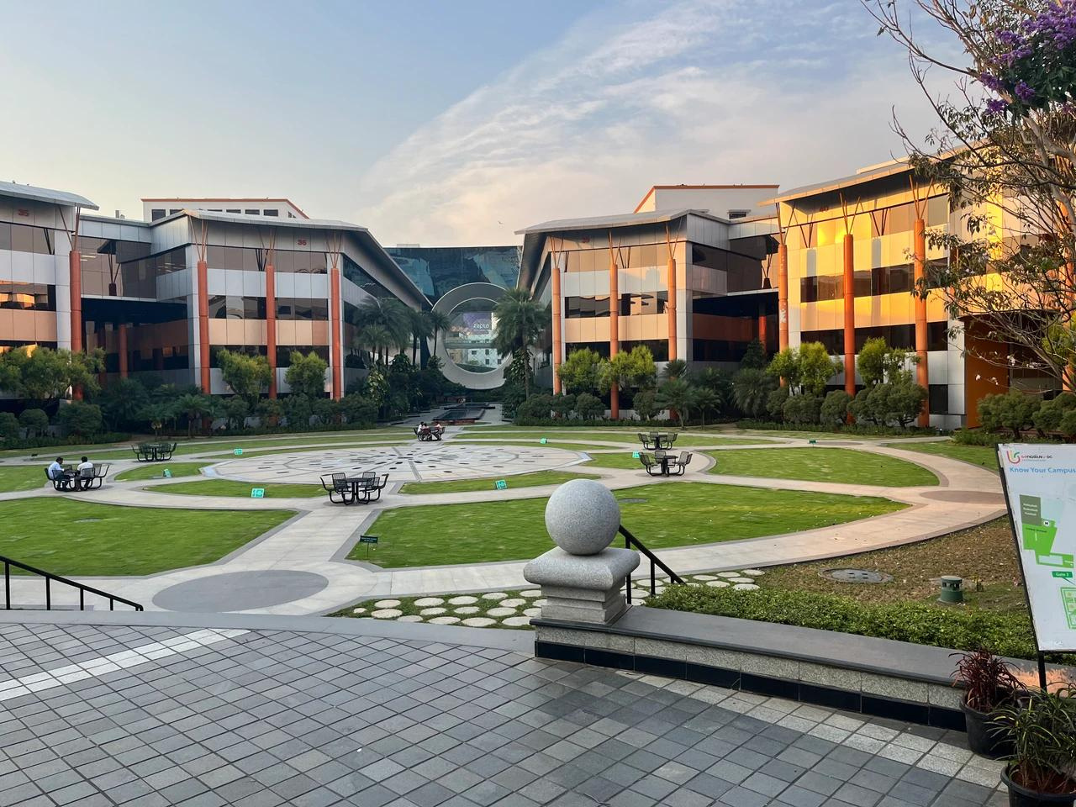
THANK YOU

